Slide 1
Level attraction in Metamaterials
Yutong Zhao
Feb 25th 2019

Slide 2
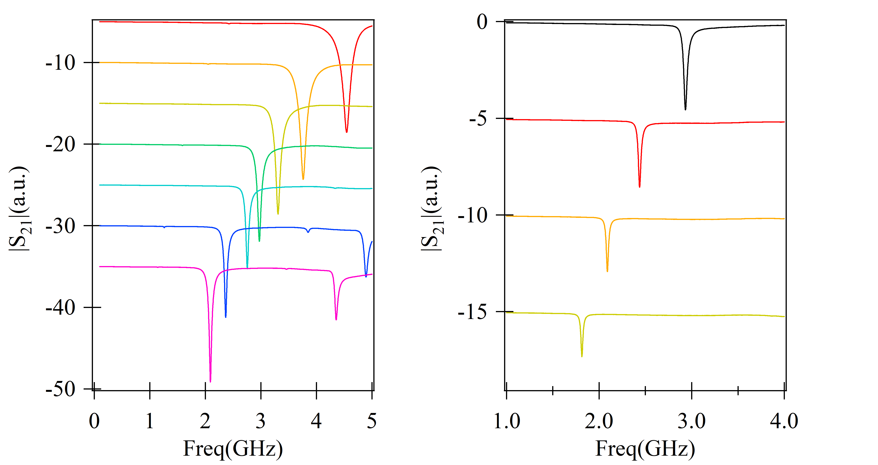
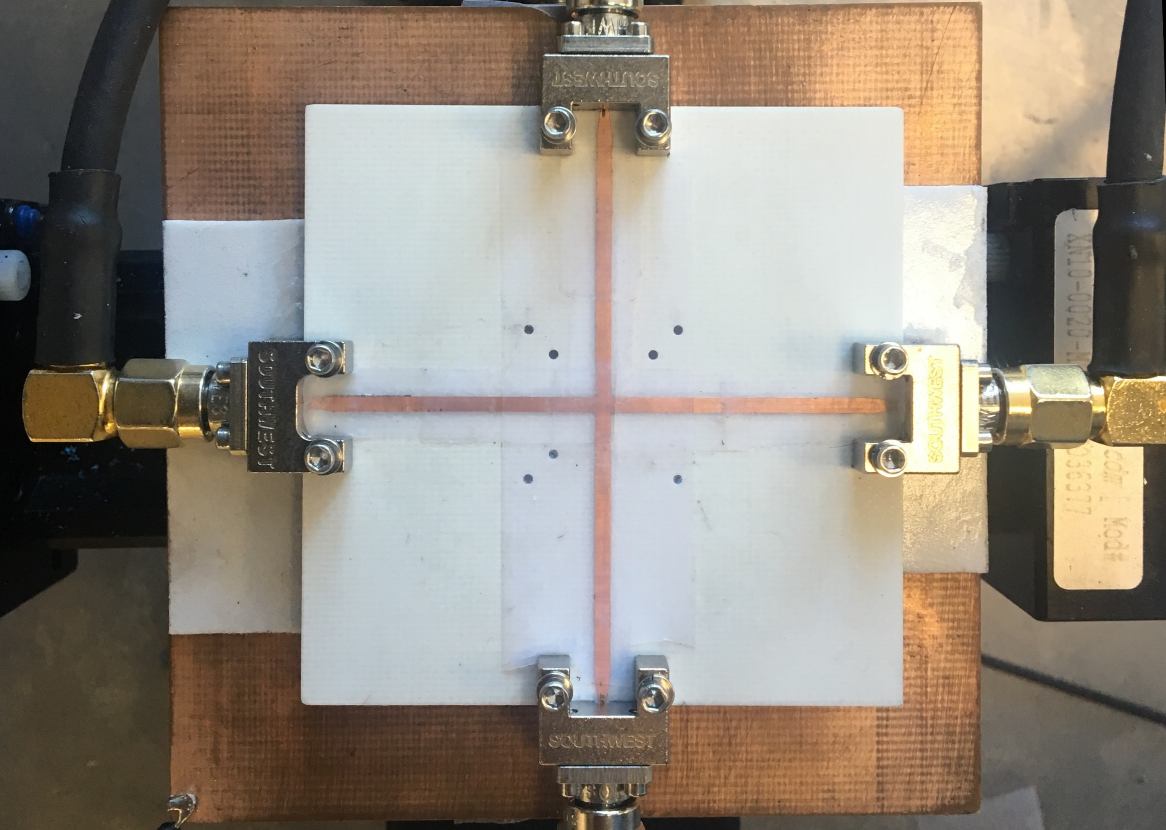
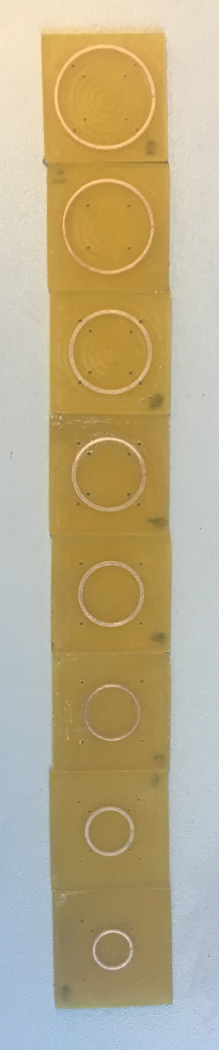
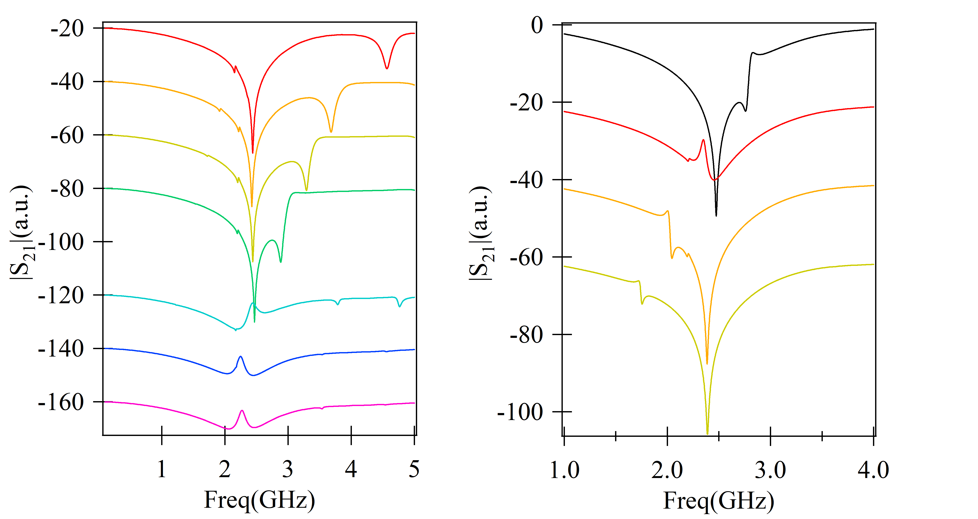
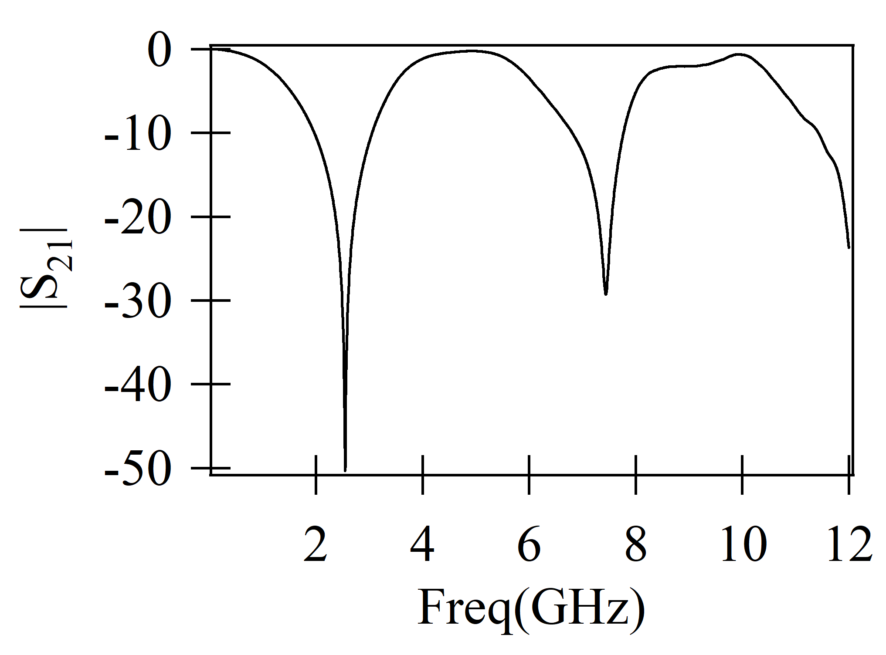
Experiment results
SRRs
6mm
5mm
open
7mm
8mm
5mm
6mm
9mm
10mm
6mm
11mm
7mm
port1
port2
12mm
8mm
7mm
open
8mm
6mm
5mm
7mm
9mm
6mm
8mm
9mm
10mm
7mm
10mm
8mm
11mm
11mm
12mm
12mm

Slide 3
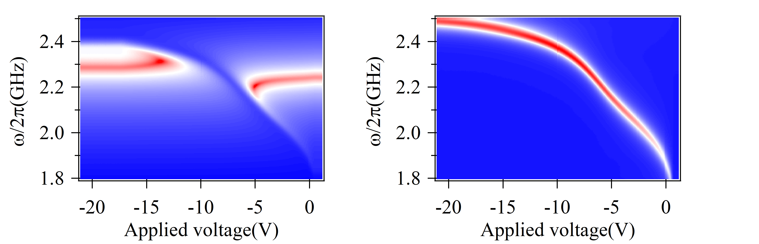
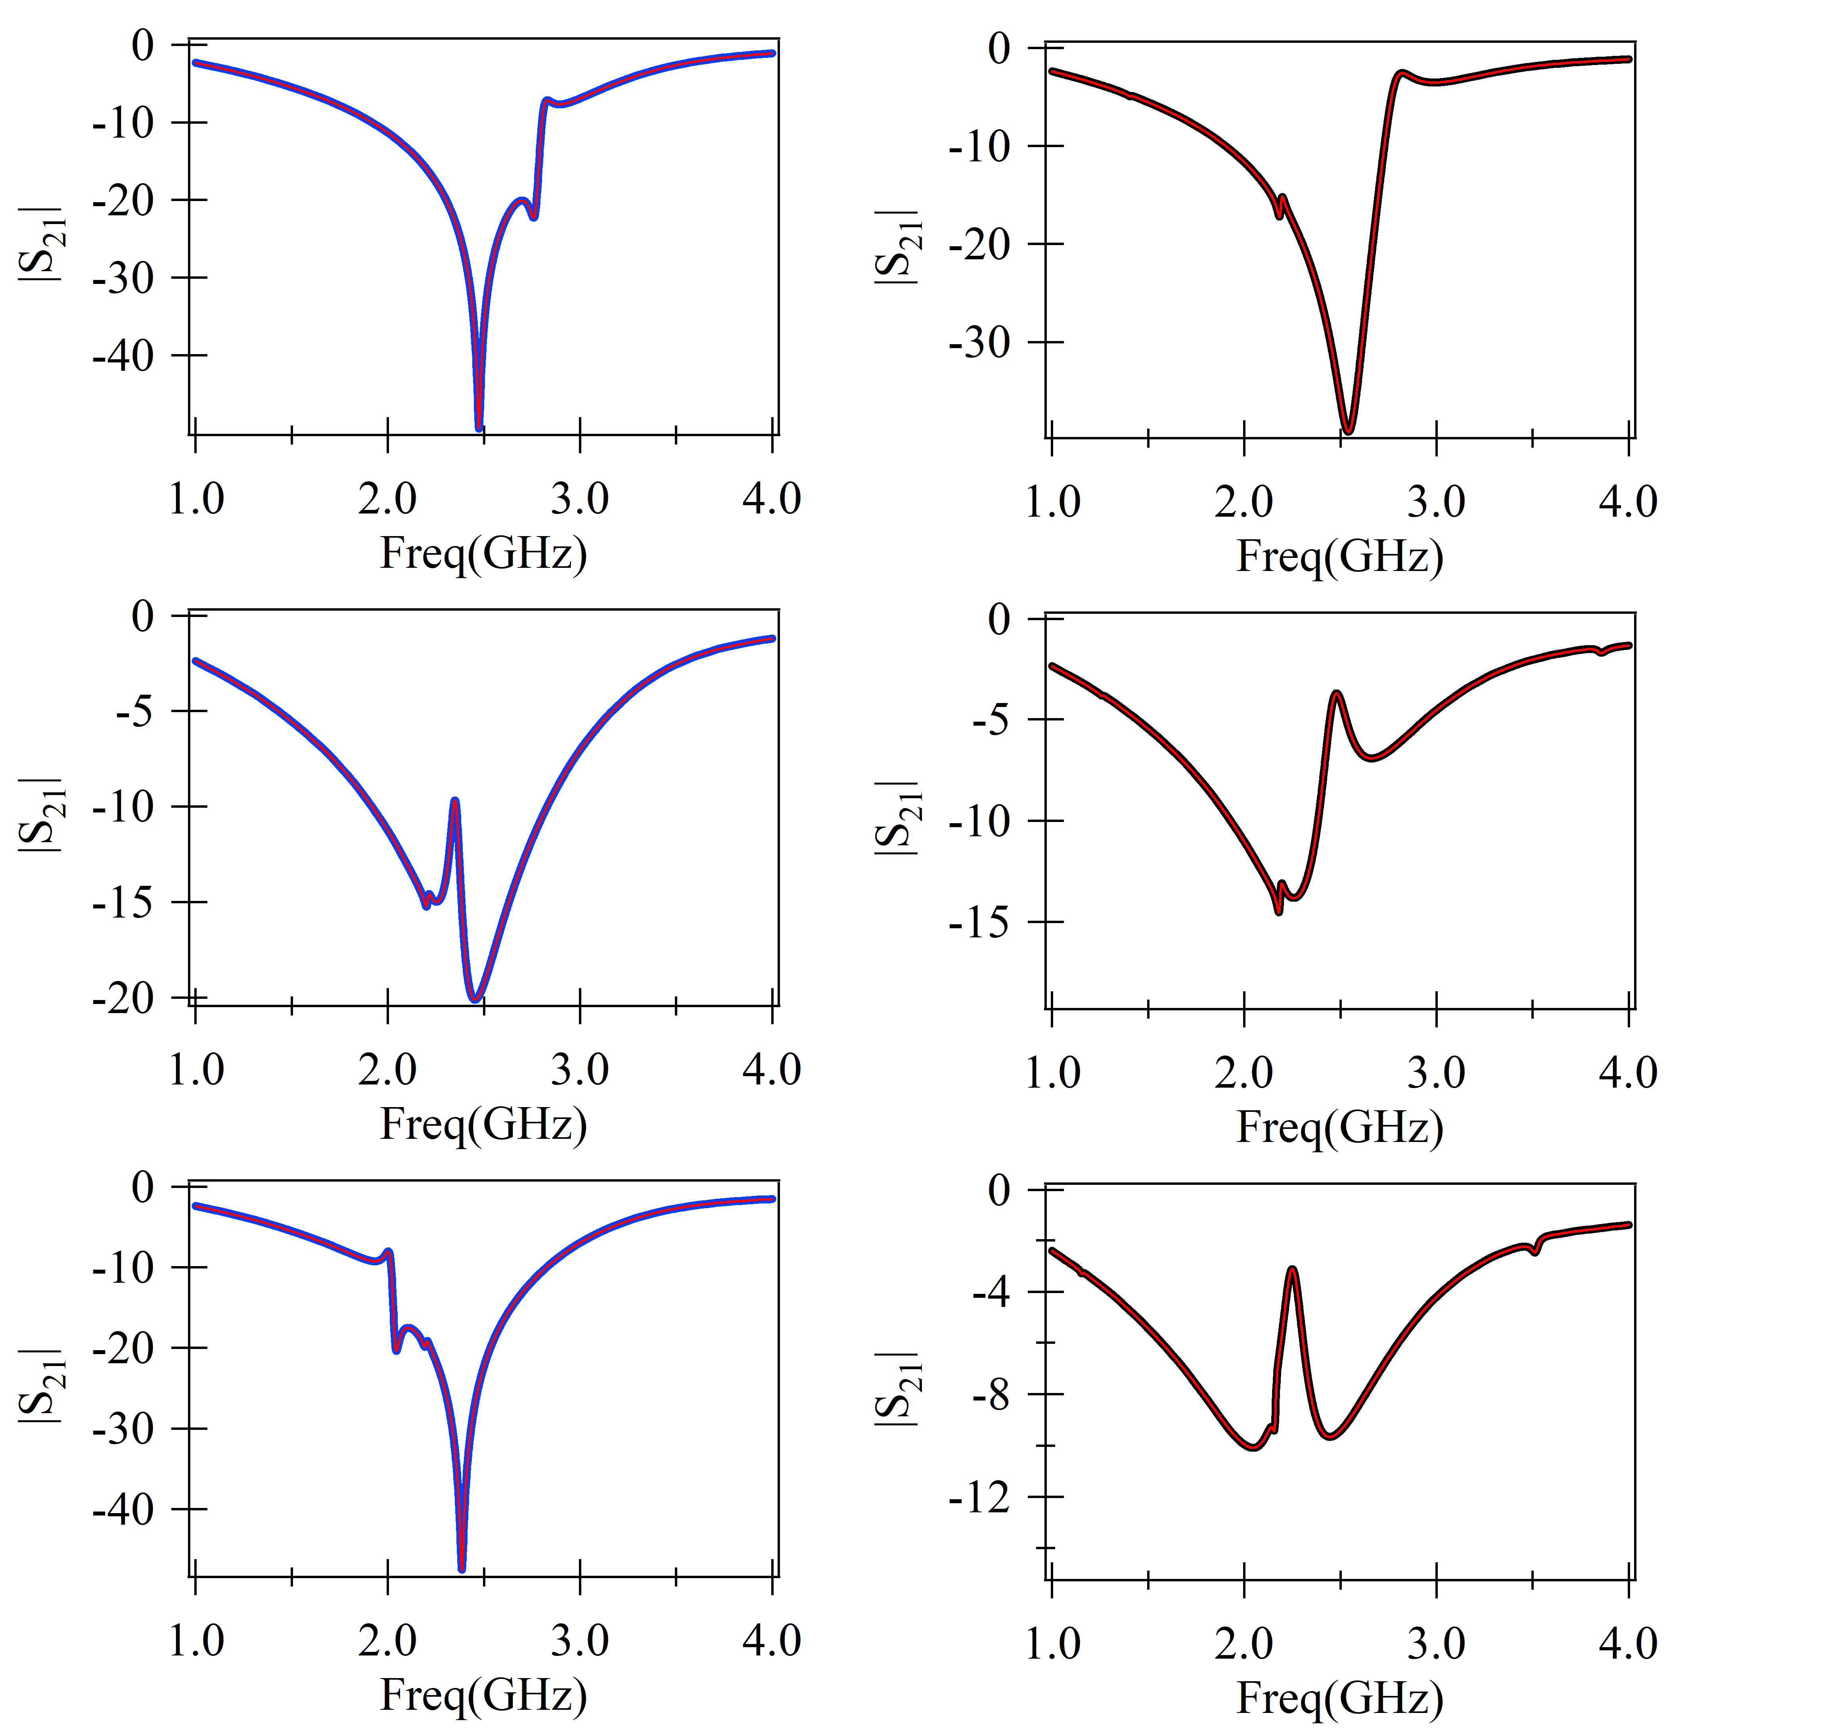
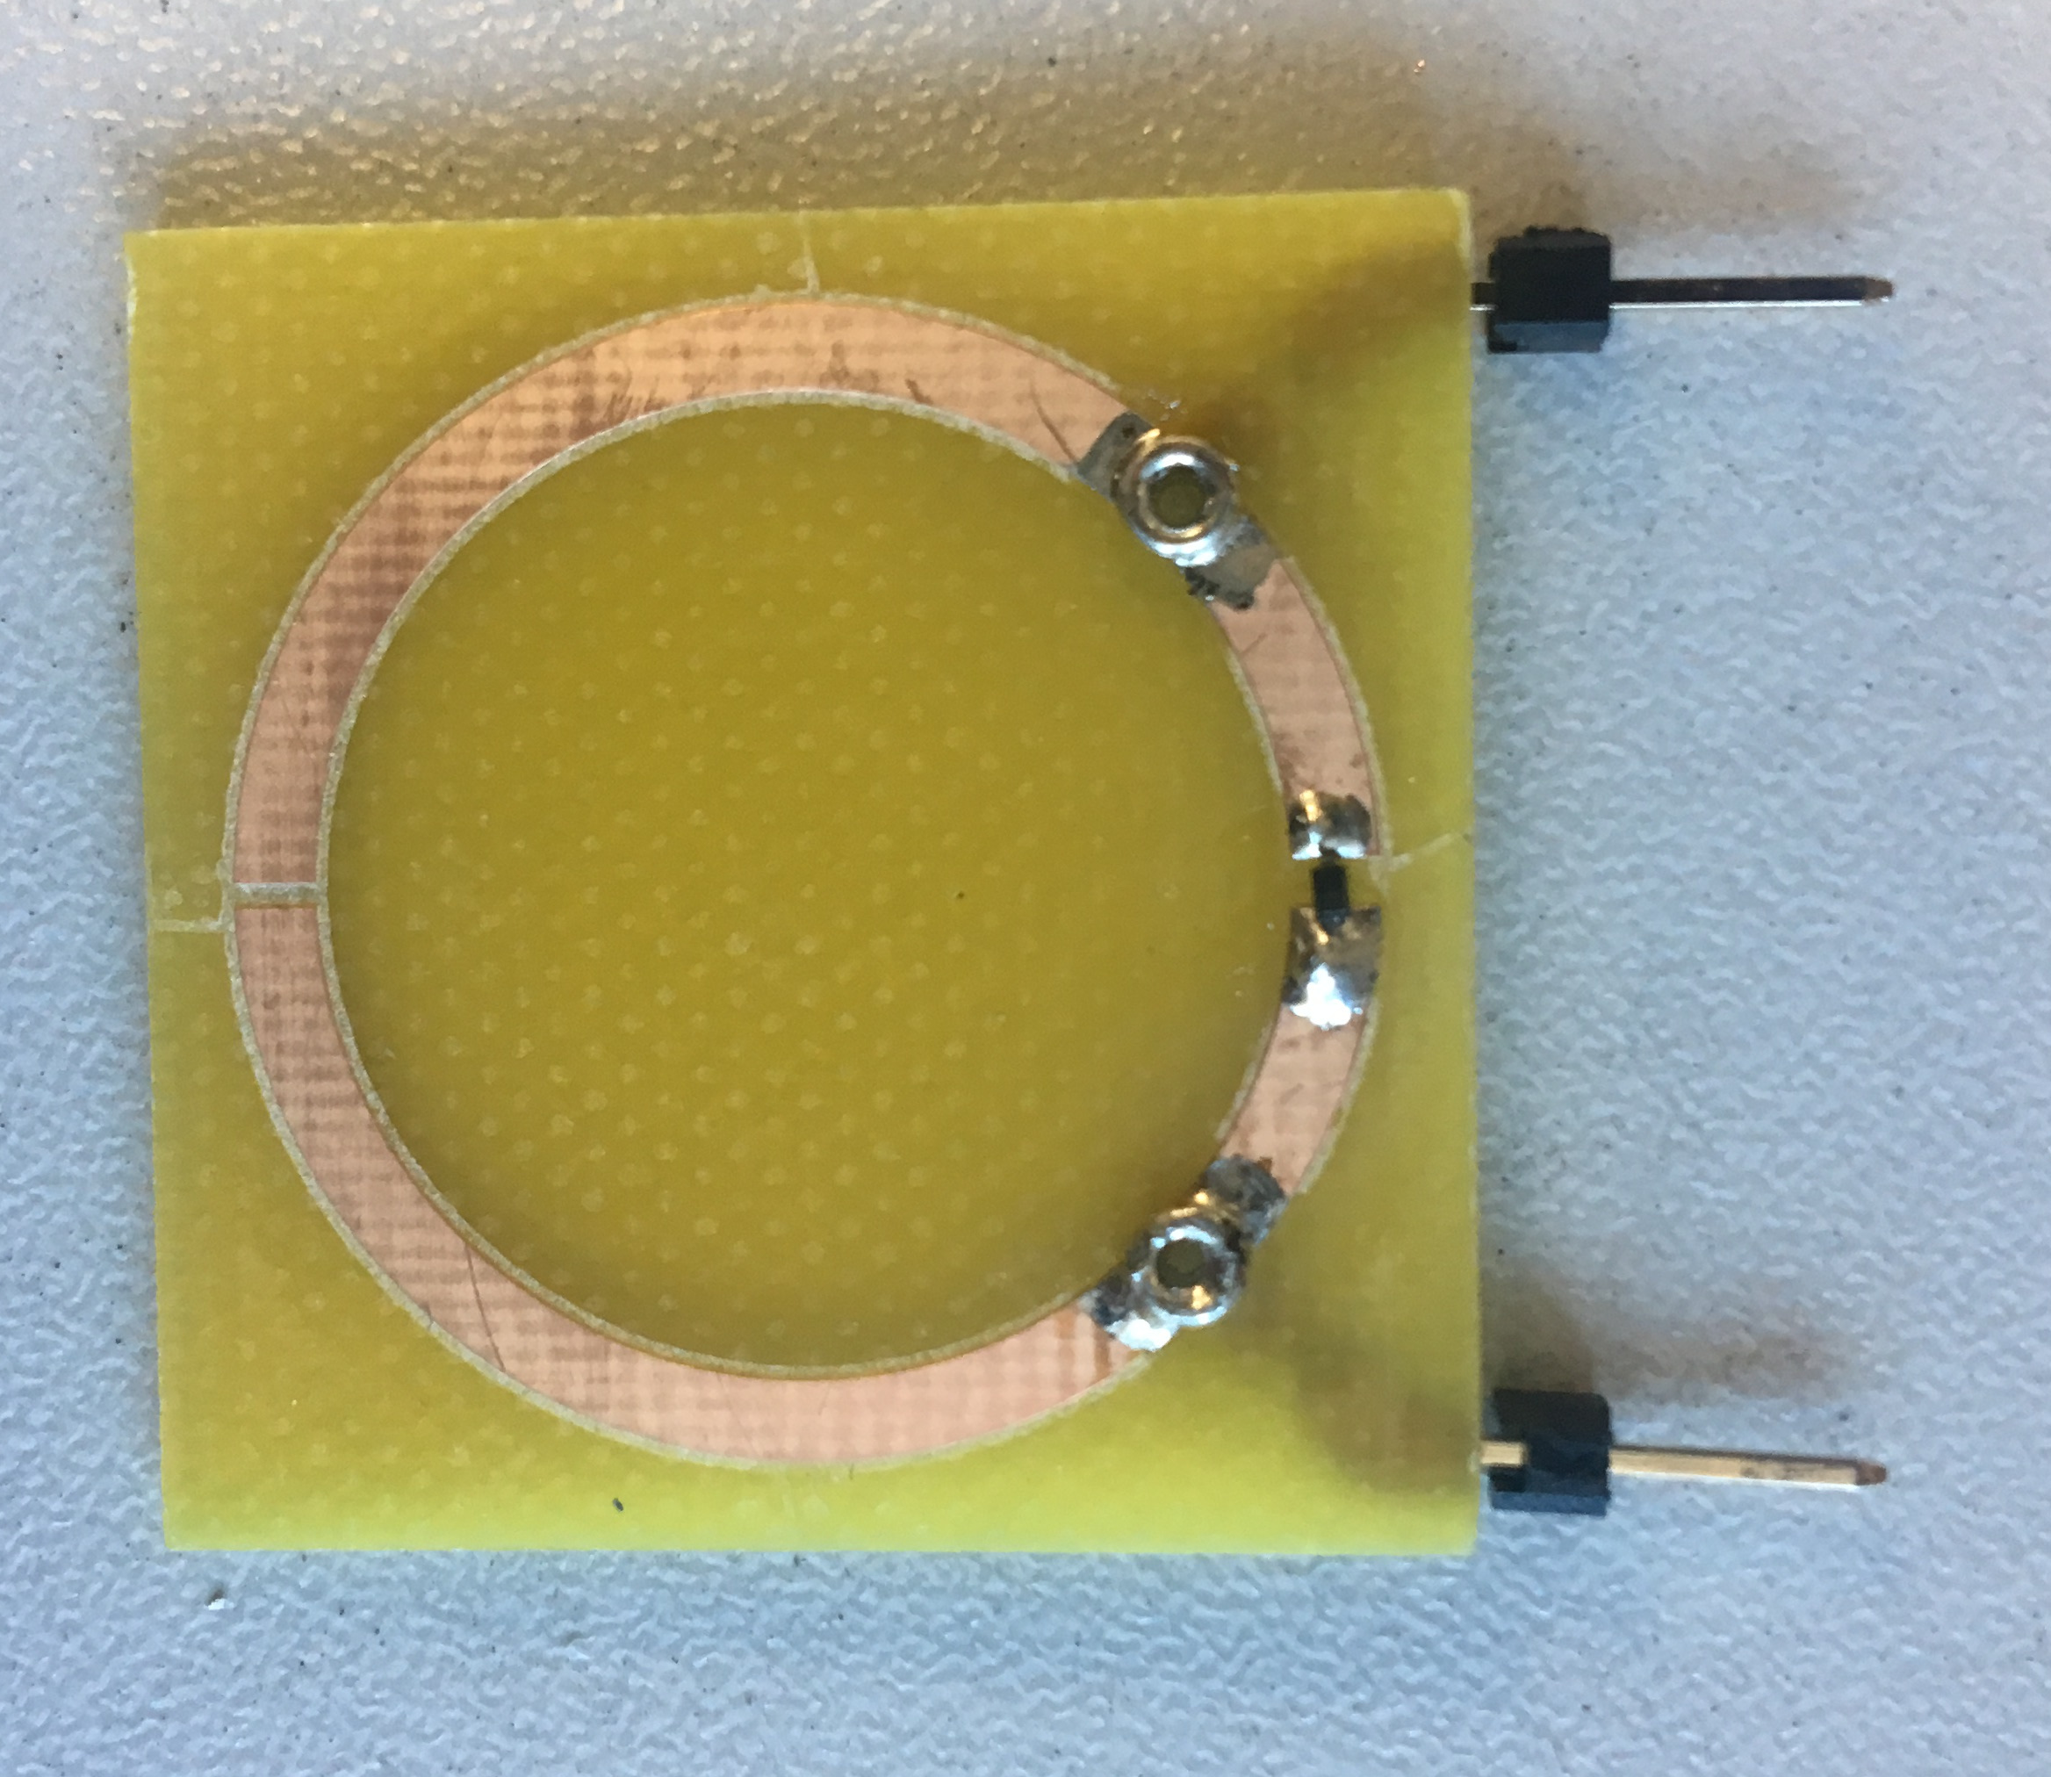
Experiment results(2)
Vara-SRR + Cross
Observe Reciprocal Phenomenon
to voltage supply
S₂₁
S₁₂
S₂₁
S₁₂
diode
varactor
inductor
inductor
Vara-SRR + transmission line
gap

Slide 4
Summary
The level attraction has been observed in metamaterial (SRR).
Currently there is no evidence for non-reciprocal phenomenon.
Next step
Use RO5880 board to reduce the damping of the SRR.
Data analysis: fitting, check phase…(2π jump or not)

